Slide 1
It's Not Just about the Data....
the Power of Driving Impact
through Intent and Interconnectedness

Slide 2

“Reinventing the Game”
We are at an inflection point.
Information is exploding & explosive
Tools & technology are enabling
Talent is paramount
Value creation from what was previously dismissed

Slide 3
Are you learning as fast as the world is changing?

Slide 4


MasterCard Information Services
Enabling decisions at the speed of consumer behavior.
Differentiation starts with data sourced from a massive worldwide payments network
    Anonymous
    Transaction amount ($)
    Transaction location at zip code level
    Transaction date
    Card account number (which is removed prior to analytics and modeling)
    Transactional
      Actual spend behavior
      Near real-time access
      Consumer / business spend
    Multi-sourced
      32 million merchants
      22,000 issuers
    Massive
      1.7 billion cards
      160 million transactions / hour
    Worldwide
Consumer insights are unmatched, proprietary and 15 years in the making
    Cleansed, aggregated, augmented
      700,000 automated rules
      Continuously tested
      Multi-sourced
    Warehoused
      1.3 petabytes
      5+ year historic global view
      Rapid retrieval
      Above-and-beyond privacy protection and security
    Transformed into actionable insights
      Reports, indexes, benchmarks
      Behavioral variables
      Models, scores, forecasting
      Econometrics

Slide 5
US Gasoline consumption by region
The number of barrels pumped is down in every region of the country
Prior to MasterCard Spending Pulse, gasoline prices in the U.S. were based solely on the supply side economics in the cost of crude oil. Now the U.S., as well as other global economies, can base the price of gasoline on both the supply and demand side economics.
  The data put out by the U.S. Department Of Energy doesn't count how many gallons are sold. Instead, it offers a "product supplied," or implied demand figure, in its weekly report. Product supplied represents the total volume of gasoline that has moved on from refineries, pipelines, blending plants and terminals on its way to supplying retail stations.
Notes:
For reference:
http://www.nasdaq.com/article/us-gasoline-use--31-in-week-to-8009-million-bd--spendingpulse-20120214-01246

Slide 6

Signals Hubs Are Emerging As A Core Offering
Signals Hubs are a new and critically important capability for enterprises – allowing them a never-before-available capability to rapidly maximize value from big data flows
Applications operationalize signals and bring them to the front lines to drive productivity and profit
Enterprise Operations
Specific Applications
Enterprise
Signals Hub
CONTINUAL SIGNAL EXTRACTION
Signals Hubs continually extract relevant data from inside and outside the enterprise… and turn this data into predictive signals
Only data with predictive value
Enterprise Data Warehouse
Other Internal / External Data

Slide 7

Signal Hub Example: Transforming Our Clients
Example: A Signals Hub for a Large Financial Services Client
DYNAMIC DATA FEEDS…
Opera Customer Signals Hub
…DYNAMIC APPLICATIONS
INTRA-ENTERPRISE DATA
e.g., Banking transactions (branch/online)
CREDIT & RISK
INTER-ENTERPRISE DATA
  e.g., Call center logs
MARKETING
Time
FRAUD
EXTRA-ENTERPRISE DATA
e.g., Bureau data
  ONGOING SET OF PREDICTIVE SIGNALS
  e.g., Changes in Social/Work Situation,
  Changes in Financial Health,
  Category Spending Trends/Opportunities
Continuous Feedback
Tangible Profit/Productivity Gains:
$60MM in annual bust-out fraud savings at a Top 5 bank
$45MM NPV for a portfolio of a Top 3 card issuer by optimizing credit line management
2X efficacy and speed of compromise detection at a large card network

Slide 8
“The real act of discovery consists not in finding new lands but in seeing with new eyes.”
Marcel Proust

Slide 9

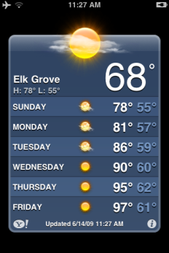



The Health Data Initiative: turning HHS and sister organizations into the “NOAA of health data”
Weather newscasts
Weather websites
Weather mobile apps
Weather insurance
And more
Weather data
FUELS
Made available to the public
Notes:
9

Slide 10






HDI goal: a self-propelled, open “ecosystem of innovation” using data to improve health (and create jobs of the future)
A Rapidly Growing Array of Innovative Products and Services That:
Help consumers take control of their health and health care
Help employers promote health and wellness
Help care providers deliver better care
Help journalists shed light
Help local leaders make better-informed decisions
Support all of the above through “data intermediary” services
And much more
Health-Related Data from
FUELS
Notes:
10

Slide 11
What kinds of data are we liberating?
Community Health
Govt Spending
Provider Directories & Quality
HHS
Data Being Liberated
Medical/
Scientific Knowledge
“Blue Button”
Consumer Product Information
Notes:
11

Slide 12
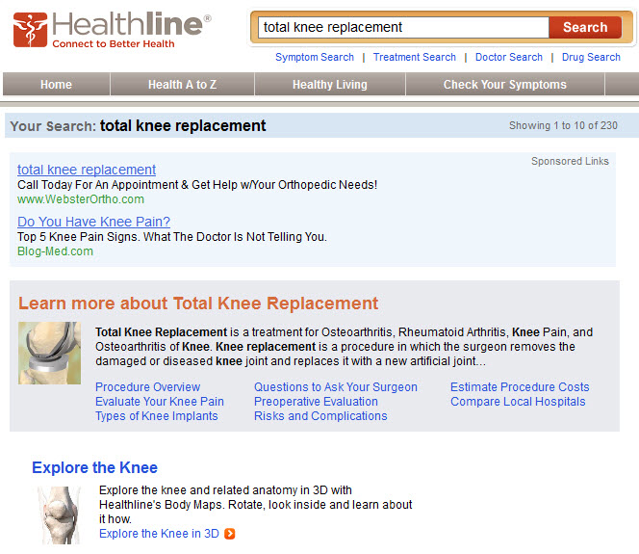
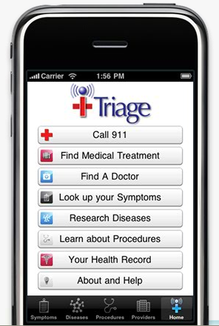
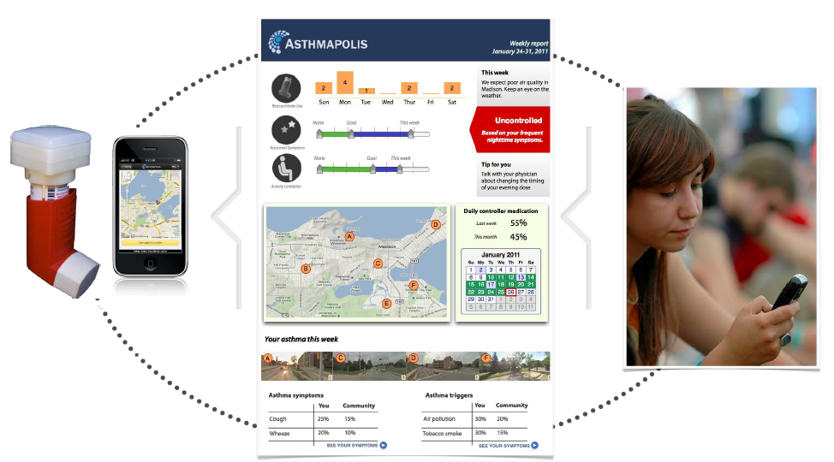
Examples: helping consumers take control of their health and health care
iTriage
Healthline
Vitals.com
Patients Like Me
Asthmapolis
Food Oasis

Slide 13
“The best source of new ideas in your field can be old ideas from unrelated fields.”
Bill Taylor, Co-founder, Fast Company

Slide 14
Cross-Sector Collaboration
Financial Services Healthcare
Dynamic regulatory, economic and information technology environments
  Applying the evolution of “credit infrastructure” to Healthcare
  Interconnectedness between Financial Services & Healthcare
  The role of “digital payments” in the ecosystem
Innovation in one industry is “business as usual” in another

Slide 15
“Sound is going to be bigger than video…‘Record’ is the new QWERTY”
Alexander Ljung, Founder & CEO, SoundCloud

Slide 16

Applications of Speaker Recognition
www.RecognitionTechnologies.com
“Big Data” from Language Proficiency Exams
150,000+ Total Sessions over 8 years (Telephony)
One Unique Speaker (candidate)
Mixed Telephone Handsets
100+ Speakers (interviewers)
60+ Different Languages
(minimum of 1 minute in English per session)
500,000+ Total Sessions over 5 years (Computer Interface)
One Speaker per Test Session
Capabilities Derived from this Data
Continuous Speaker Verification
Automatic Language Proficiency Rating
Speaker Segmentation + Tracking
Language Detection
Large-Scale Speaker Identification
Potential Impact to Language Proficiency Exams
Lower Fraud
More Affordable Automatic Tests
Quicker Testing and Evaluation
Proctorless Testing
Higher Granularity in the Assessment Levels
No Raters
Copyright: Recognition Technologies, Inc.
Feb 14, 2012

Slide 17
Applications of Speaker Recognition
www.RecognitionTechnologies.com
Language Proficiency Exams
(Candidate Authentication & Automatic Rating – 60+ Languages)
Pre-Registered
Candidate
Internet and
Telephone Network
Interviewer
Automatic Fraud Detection
Examiner
RecoMadeEasy®
IVR* + SPKR**
RecoMadeEasy® Engines:
* IVR: Interactive Voice Response Engine
** SPKR: Speaker Recognition Engine
*** ALPR: Automatic Language Proficiency Rating Engine
Automatic Proficiency Rating
RecoMadeEasy®
ALPR***
Copyright: Recognition Technologies, Inc.
Feb 14, 2012
Notes:
17

Slide 18


Applications of Speaker Recognition
www.RecognitionTechnologies.com
Building and Bridge Health Monitoring
Speaker Recognition Techniques enable Recognition of the Vibration Signature of Structures
Define “Normal” Conditions through Learning
Recognize Deviations from the “Norm”
Capture “Big Data” from Varying Locations on Healthy Structures
Validate Recognition of Damages through Simulation
Opportunity:
Health Prognosis of Buildings and Bridges
Damage Detection after Natural Disasters
Potential Impact:
Quicker assessment of Damages
after natural disasters
Realtime Proactive Assessment of Damages
Reports on Localization of Damages
Copyright: Recognition Technologies, Inc.
Feb 14, 2012

Slide 19





























NICE Interaction Analytics Methodology
Interaction Analytics
Capture
Emotion Detection
Call Flow Analysis
Speech Analytics
Desktop Analytics
Talk Over Analysis
Phone
Email
Phone Survey
Social Media
Chat
Web
this is the third time I am calling
transfer
disappointed
Website issue
Alert
Categorization
Root Cause Analysis
Real Time Impact
 | 0 | 25 | 75 |  | 100
Status check
Delivery delay
Agent
Support
80
60
40
20
19
Notes:
NICE Systems is the worldwide leader of enterprise business solutions that capture and analyze customer interactions and transactions, realize intent, and extract and leverage insights to deliver impact in real time.
Driven by cross-channel and multi-sensor analytics, NICE solutions enable organizations to improve business performance, increase operational efficiency, prevent financial crime, ensure compliance, and enhance safety and security.
First, the captured interactions are automatically analyzed from as many different dimensions as possible, across the many different channels we’re using to communicate with our customers (phone conversations, chat, email, web activity etc.).
Speech & Text Analytics technologies (such as Phonetics Indexing & Call Transcription) allow you to automatically identify key words and phrases that were spoken or sent in the interaction and also allows you to uncover negative or positive emotion on the part of the agent or customer.
The first step is to start asking the system to automatically catalog or categorize the interactions based on a the content identified within it, which provides a structured way of quantifying exactly which TYPES of calls we’re getting.
By using automatic categorization we can begin to look at those interactions that are more interesting to us, for example: The Blue category could be interaction related to customer satisfaction issues, the Red category could be a list of call where a competitor’s name was mentioned, the Yellow category could be interactions where a customer complained this is a repeat call, on an issue that was not resolved previously.
Once we have the system automatically categorizing our interactions, we track how the trends change over time and see how these call types are behaving.
Now, it’s a great thing to be able to know WHAT is happening, whether certain call types are exceeding their historic values etc. But once we know that, the next thing we ask ourselves is WHY it is happening…So an important part of any interaction analytics solution is the ability to drill down into specific interactions using advanced automated tools and find out what are the root causes.
At the end of the day all this information needs to be impactful and embedded in a repeating business process, so that we can make informed data-driven decisions about which coaching areas we want to invest in, what processes we might want to look at or even what we may want to change in our products or offerings.

Slide 20

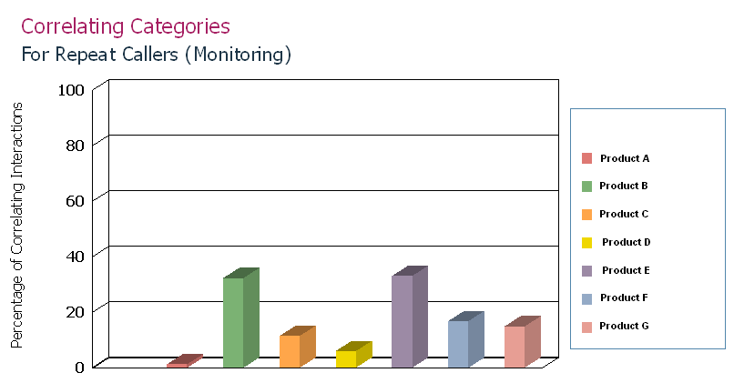
Business Process Implemented
Customer Interaction with Contact Center / Support
Quarterly meetings between Operations, Product & Development teams
Interactions analyzed automatically – customer Insight generated
Provide specific product enhancements project requests based on Insight generated from customer interaction
Notes:
Continuously improving the quality of Go Daddy products is essential to increasing customer satisfaction and lowering support costs by reducing the volume of support requests. The following describes the approach that was taken to improve product quality using the Voice of the Customer:
Interaction Analytics team – Provided automated customer Insight related to product-specific usability enhancements to the Product Sponsorship Teams.
Product Sponsorship team– Turned the insight into elaborate functional requirements in the form of a project requirements document. Cost/revenue impact analysis was also provided along with recommendations.
Development team - Quarterly meetings with Product and Interaction Analytics team members to report on progress of existing remediation projects and to be presented with new remediation projects.

Slide 21
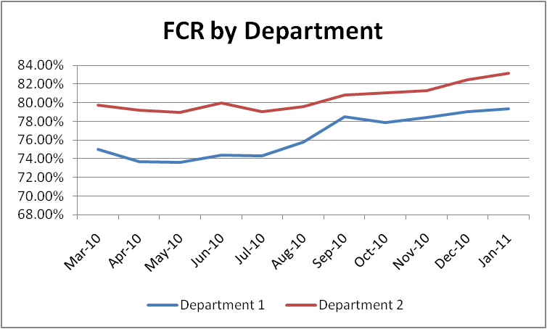
Business Impact - Example
Results
Nearly $2 million annual savings directly attributed to eliminating repeat calls
  Increased FCR from 78% to 83% (23% reduction in repeat calls)
  Eliminated over 300K repeat calls annually
  Increased customer satisfaction scores from 88% to 92%
  Key product categories showed decrease in repeat calls by as much as 50%
Additional $280K annual savings with 20% increase in number of evaluations completed per agent, without increasing QM evaluator headcount
Increased sales through operational efficiency by investing additional time on up-sell/cross-sell activities
Notes:
By identifying Repeat Callers (based on Speech Analytics as well as transactional data) and correlating those calls with specific content and topics discussed on those interactions, Go Daddy were able to clearly understand the root causes behind the majority of repeat calls and come up with a training and process-change plan to address the “lowest hanging fruit”. This resulted in substantial reduction in repeat callers (overall 23% reduction, and for some specific products up to 50% reduction in repeated callers).

Slide 22
"The market has moved away from seeking point solutions as companies have begun thinking of the data quality problem as very far-reaching and pervasive.[But] unless you're ensuring the quality of what's being delivered, then you're just like a faster manure spreader. You're just taking the crap data that's sitting in most companies‘ systems and you're spreading it around the organization.”
Ted Friedman, Gartner

Slide 23
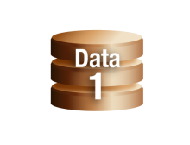

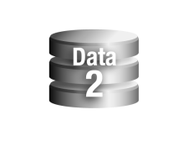

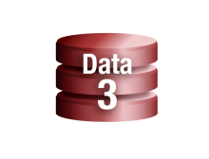

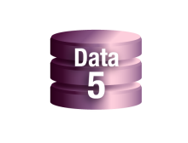
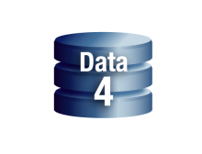

Optimized Data Sources
Eliminated Sources
Source 3: $1.8 MM
Source 5: $3.7 MM
Total: $5.5. Million
Optimized Sources
Data Dimension Metrics
Accuracy
Completeness
Coverage
Relevancy
Consistency
90
86
89
88
87
Data Costs
$22.72MM
50
60
70
80
90
100

Slide 24
Data Ethics – Ethical Analytics
With more granular insights comes greater responsibility
Just because you can, doesn’t mean you should
A culture of “ethical” analytics

Slide 25
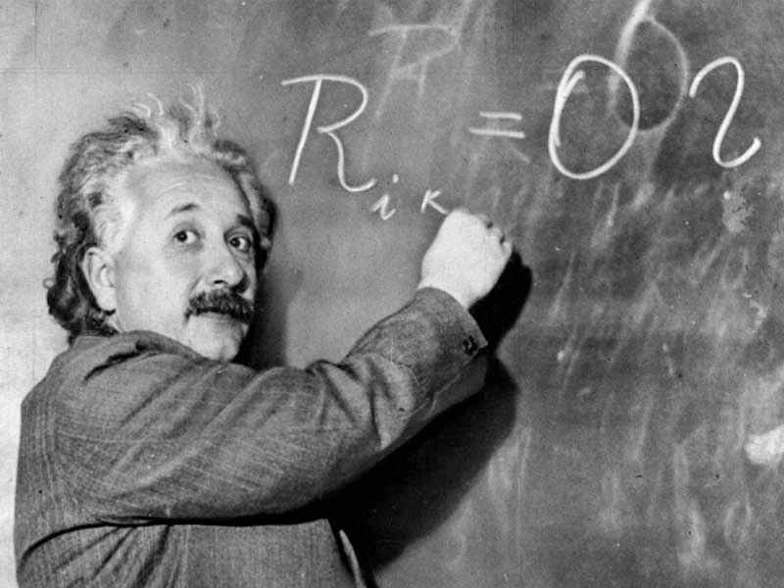
Today’s leaders must connect deep understanding to execution…international leadership is crucial to solving the global challenges and complexities surrounding them
“Vision without execution is merely hallucination.”
Albert Einstein

Slide 26
Tal Solutions, LLC
Marcia Tal, Founder
marcia.b.tal@gmail.com
(917) 957-5805

